Slide 1
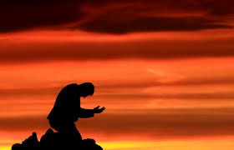
主啊，有誰能像祢
Who Is There Like You

Slide 2
祢常為我擺設筵席
我的生命充滿驚喜
我有何能報答祢的厚恩
千言萬語也述說不盡
All my life is full of Your grace
At Your banquet, You save me a place
These are wonders, that I can ne'er repay
They are more than all words can say

Slide 3
我是誰祢如此眷顧
寧處貧窮使我富足
我算什麼祢竟這樣愛我
除祢以外我還求什麼
What am I that You would take note
What am I, Lord, that You'd love me so
By Your richness, in You my life o'er flows
Any greater joy I don't know

Slide 4
主，我讚美祢，一生歌頌祢
主啊，有誰能像祢
主，我敬拜祢，滿心感謝祢
唯願一生事奉祢
I‘ll ever praise You, give glory to You
For who is there like You
Yes, Lord, I praise You, give glory to You
All my life, I'll serve only You

Slide 5
我是誰祢如此眷顧
寧處貧窮使我富足
我算什麼祢竟這樣愛我
除祢以外我還求什麼
What am I that You would take note
What am I, Lord, that You'd love me so
By Your richness, in You my life o'er flows
Any greater joy I don't know

Slide 6
主，我讚美祢，一生歌頌祢
主啊，有誰能像祢
主，我敬拜祢，滿心感謝祢
唯願一生事奉祢
I‘ll ever praise You, give glory to You
For who is there like You
Yes, Lord, I praise You, give glory to You
All my life, I'll serve only You

